Slide 1
APC Issue Tracking
Introduction and Tour of
APC’s JIRA Issue Tracker

Slide 2
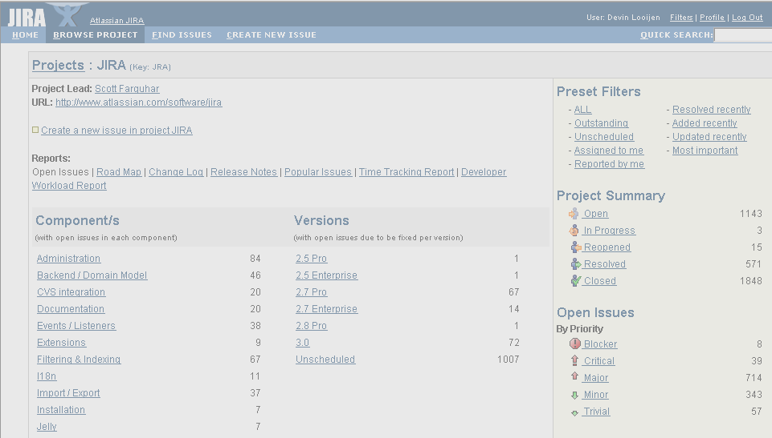
JIRA

Slide 3
Properties
Runs off of Web Server
Integrates with MySQL database
Browser User Interface
Highly Customizable Java

Slide 4
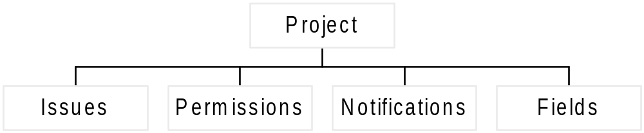
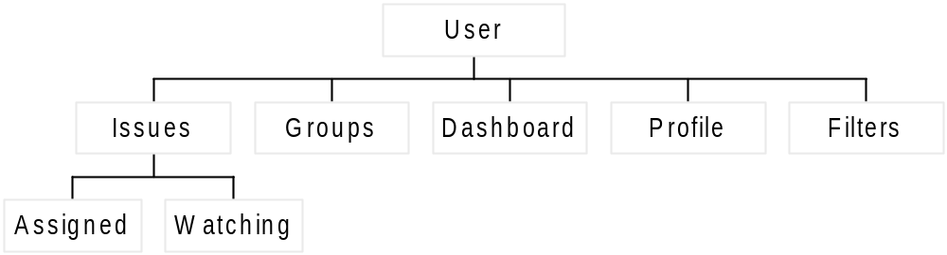
JIRA Hierarchy

Slide 5
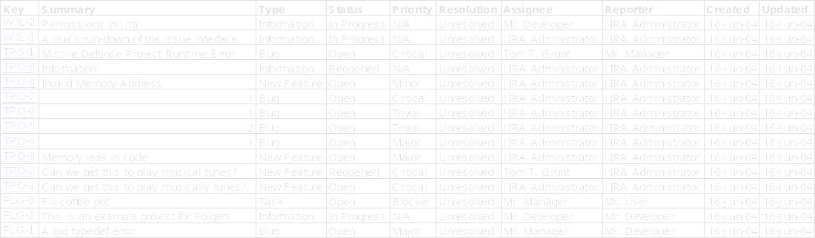
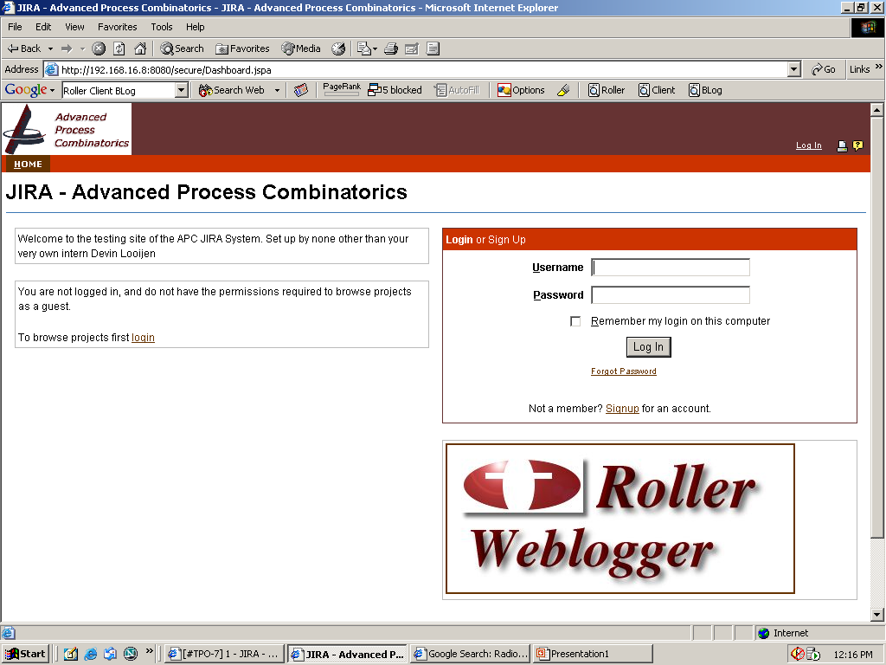
Login and Setup
Go to :8080/jira
Logins are lowercase
Link to APC’s blogging service

Slide 6
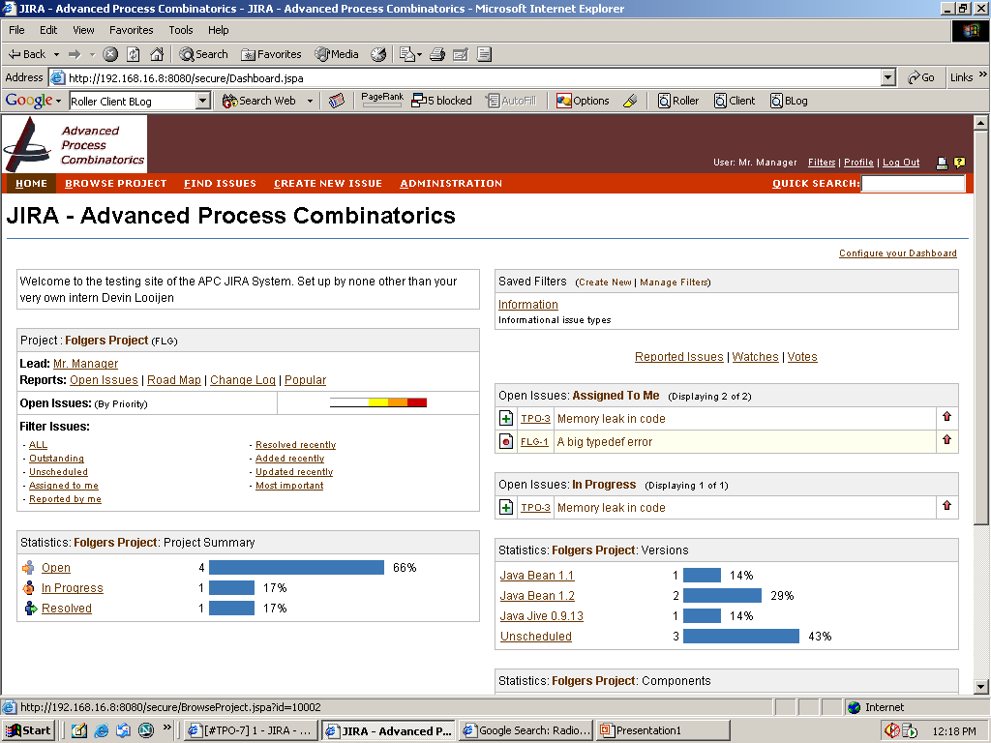
Dashboard / Home
Navigation Bar
Dashboard Settings
Project Links
Assigned Issues

Slide 7
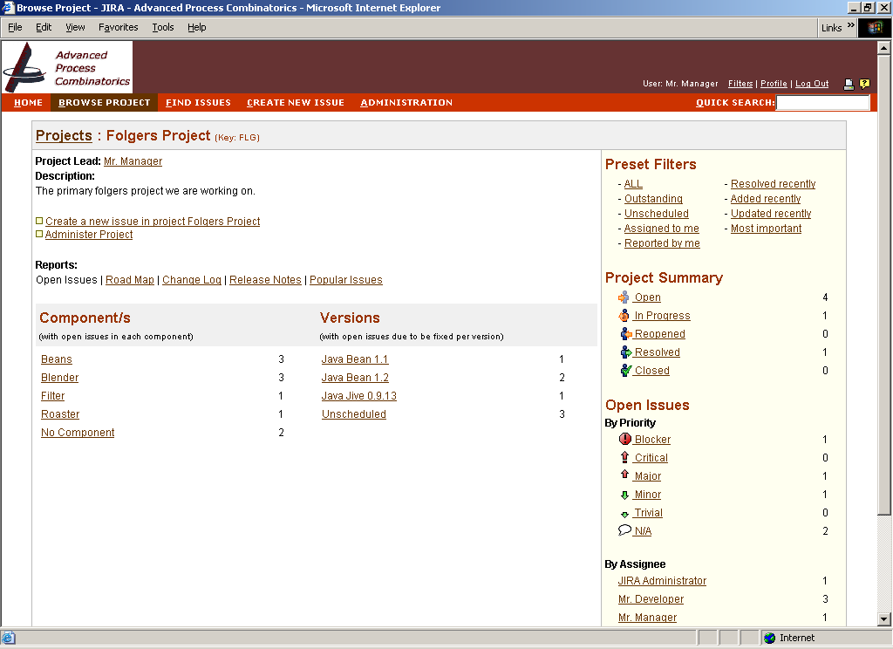
Browsing a Project
Add New Issue
Issues by priority, presets, assignee
Issues by Component, Version

Slide 8
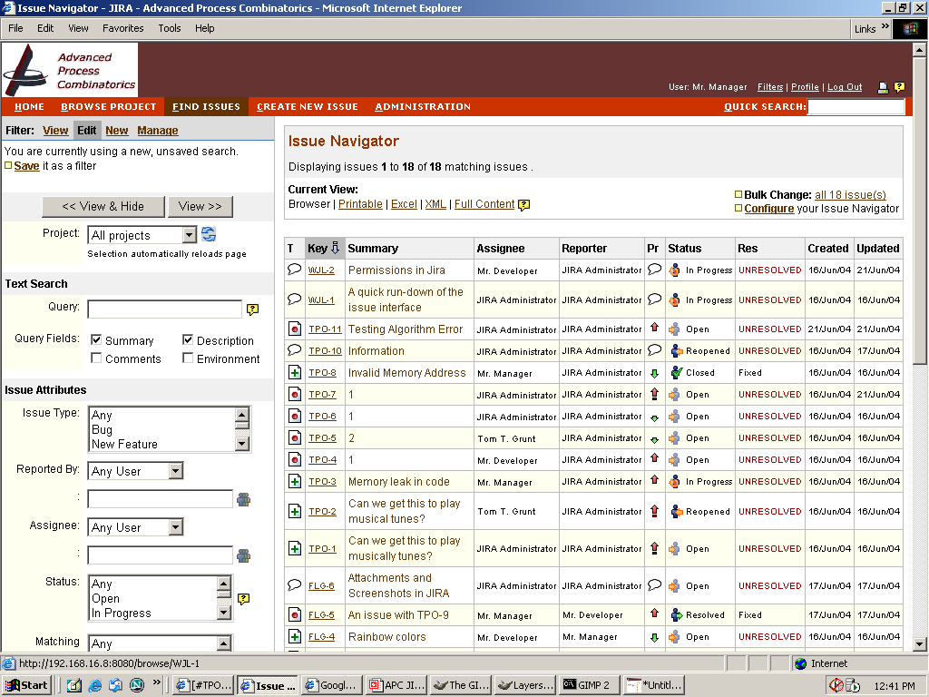
Find Issues
Filters can be customized per user
Filters can be saved
Various search criteria available
Save / Edit
Viewing Options
Criteria
Results

Slide 9
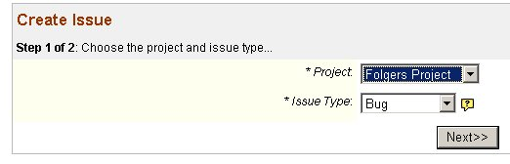
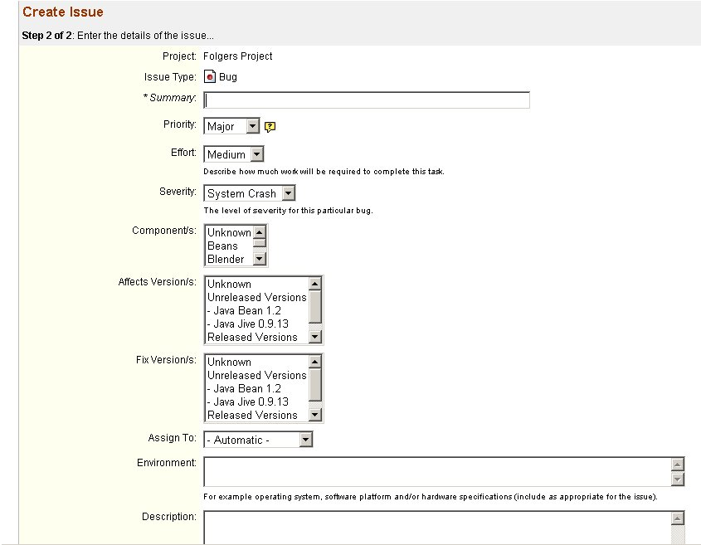
1. Select Project
2. Select Issue Type
(Bug, Feature, Etc.)
Creating an Issue
3. Add Details:
(priority, summary, description, components, fix versions etc.)

Slide 10
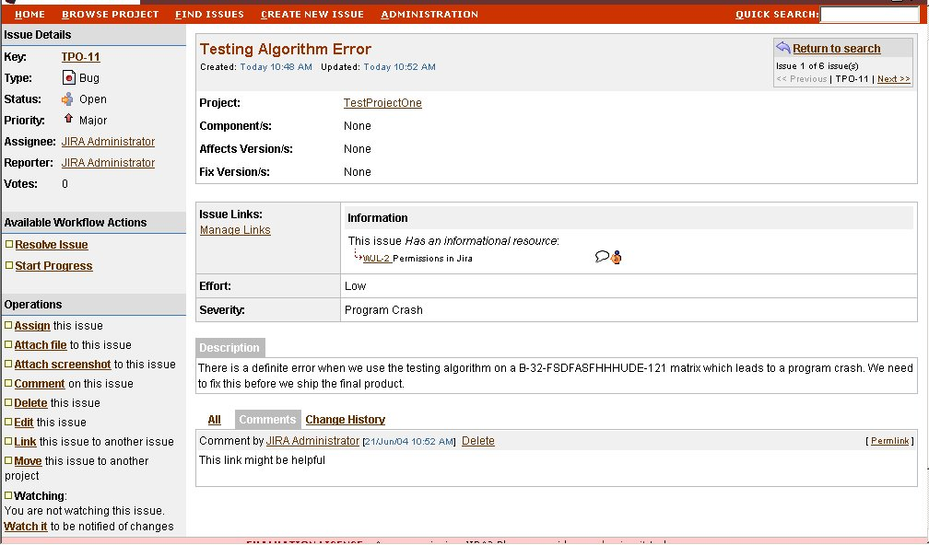
Viewing / Editing an Issue
Issue Breakdown
Issue Description and Details
Start Progress on Issue
Comment, edit, link, attach shortcuts
Comments and History

Slide 11
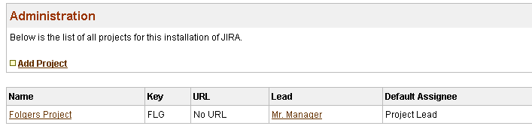
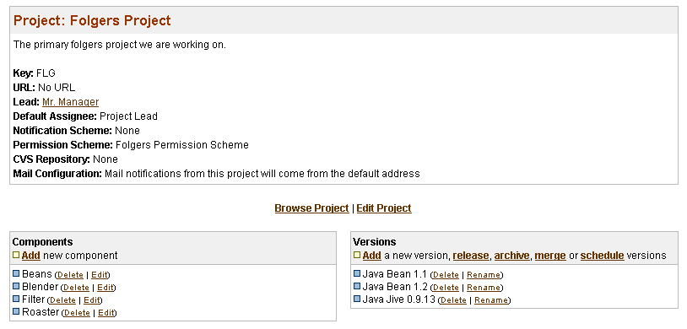
Project Administration
Select Project
Project Details
Add / Rename Components
Manage Versions

Slide 12

Things to Watch out for…
When using the “attach screenshot” link, you need to have the latest Java Runtime Environment (JRE).
http://java.sun.com/j2se/1.4.2/download.html
Attaching a .jpg or .bmp screenshot as a file will work as an alternative.
If you move a file to another project, its index number will change to a unique one for that new project. If you want to find the issue by the old identifier, typing it in the box will bring up the issue.

Slide 13
Economics
Quoted from Website
Deploy a single instance of JIRA in a commercial environment on 1 server
Unlimited projects, users and issues
Free upgrades for 12 months
Full source code (under a developer source license which allows for broad customization)
Email support (9am-6pm weekdays, Australian Eastern Standard Time)
Price: $1000
-1 Server
-Lifetime License
-1 Year Upgrades
Possible CVS Integration
Large Mailing List and User Base
Runs well with Blogger Candidate

Slide 14
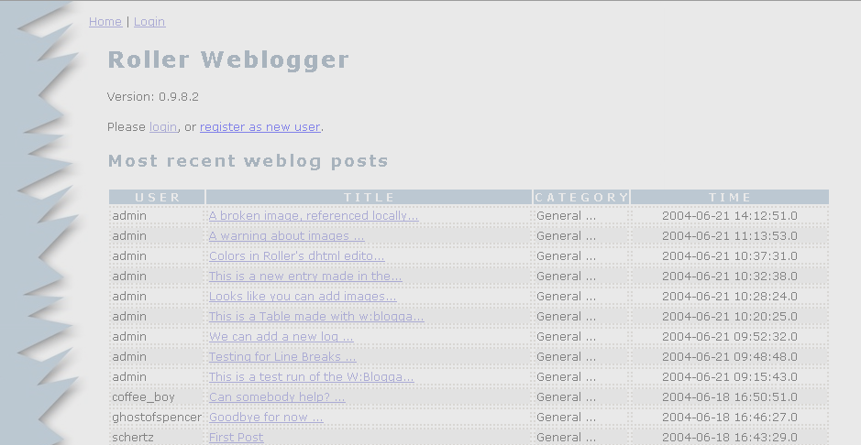
Roller
Weblogger

Slide 15
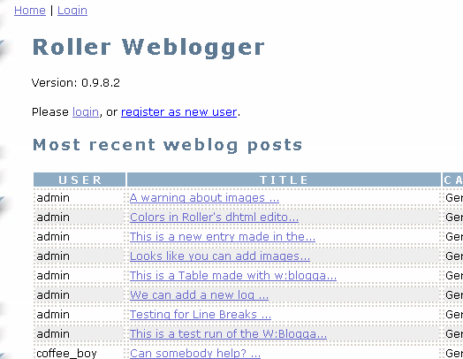

Roller Weblogger
Blogging tool linked to JIRA by customization from Intern
Customizable themes
Easy blogging

Slide 16
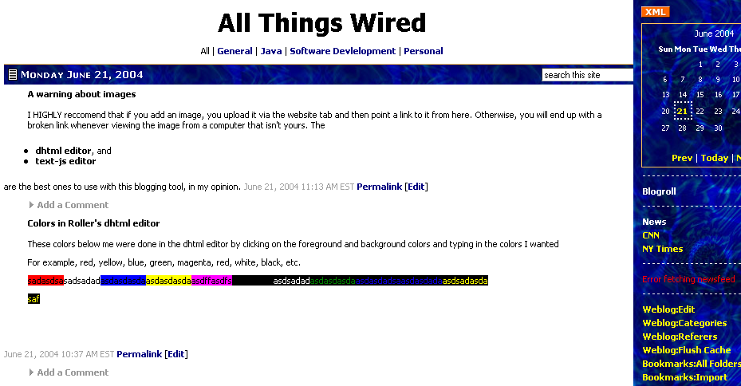
Intro
:8080/roller
Click links
to view
others’ blogs
Log in
to write
(use same user name / pass)

Slide 17

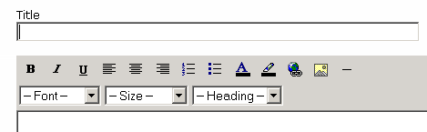
Writing / Customizing
Navbars at top
Select an editor (dhtml suggested)
Use Weblog -> Edit to write
Themes, website settings customizable via menus

Slide 18
BlogIT! APC’s Insta-Blog Tool
If you find an interesting site, click the BlogIT! Link.
This will automatically prepare a post for you about the website, along with any selected text from the page
Go to the Roller Site
Drag the BlogIT! Link into your links bar on Internet Explorer
You’re done!

Slide 19
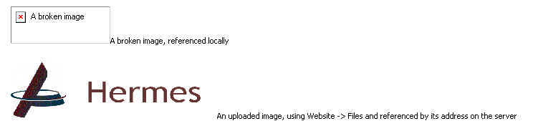
A Warning about Images
You must upload an image before you put it in your blog. (Website -> Files)
Use the address of the uploaded file to refer to your image in the blog.

